Slide 1
Group Project
Shuo-Yen Chueh, Nisrine Bakri

Slide 2
Introduction

Slide 3
Background

Slide 4
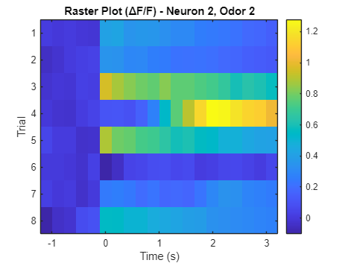
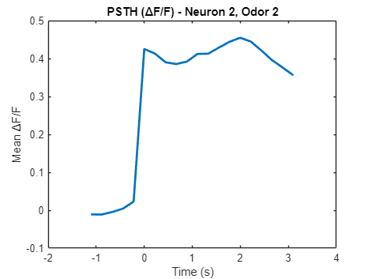
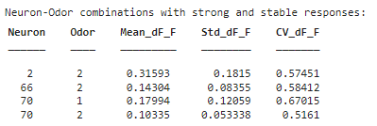
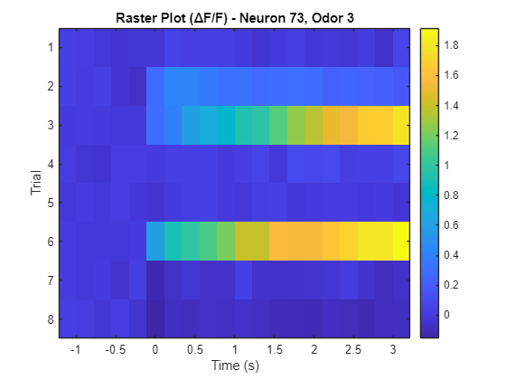
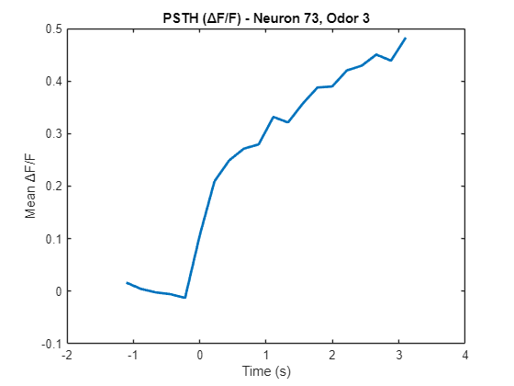
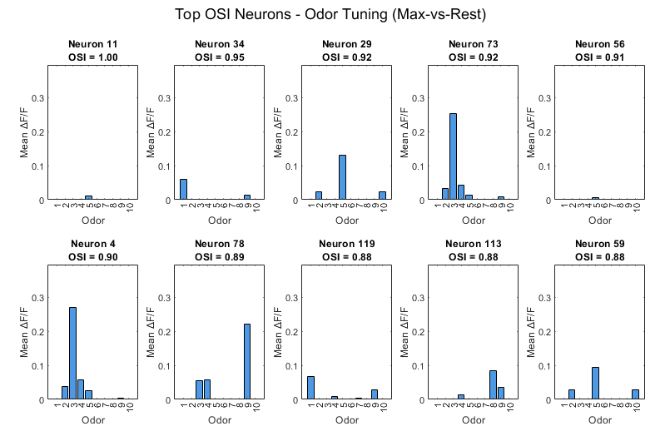
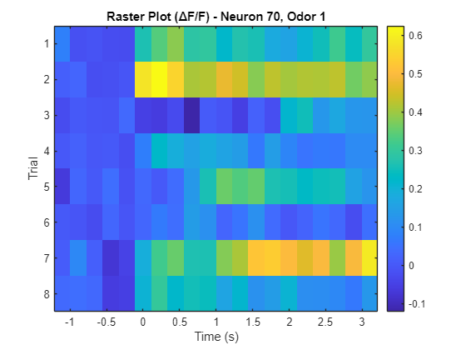
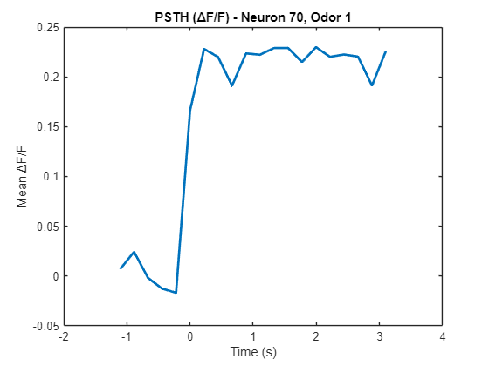
Neuron 2, OSI = 0.61
From Broad to Sharp: Tuning Curves across Selectivity Spectrum
Neuron 70, OSI = 0.4
Notes:
Sparse and Weak Odor Responses in Piriform Cortex
Overall, the majority of piriform cortex neurons exhibited low odor-evoked ΔF/F amplitudes, even when responding to stimuli. PSTH and raster plots confirmed that only 2–3 out of 8 trials typically showed clear responses, and mean ΔF/F rarely exceeded 0.1–0.3.
Additionally, trial-to-trial variability remained high: CV values for most neurons were well above the stability threshold (e.g., CV < 0.7), indicating limited consistency across trials.
Only a small number of neuron-odor pairs passed the strong-and-stable criteria (ΔF/F > 0.1 & CV < 0.7), with each animal exhibiting just 3–4 such combinations.
Some neurons on the Heatmap may have a persistent response to many odors (high ΔF/F for a long time), but the OSI of these neurons may not be high.
This is because OSI does not take into account the "duration of the response"
Which neurons respond strongly to those odors, and which respond specifically?

Slide 5
Sparse and Weak Odor Responses in Piriform Cortex
Overall, the majority of piriform cortex neurons exhibited low odor-evoked ΔF/F amplitudes, even when responding to stimuli. PSTH and raster plots confirmed that only 2–3 out of 8 trials typically showed clear responses, and mean ΔF/F rarely exceeded 0.1–0.3.
Additionally, trial-to-trial variability remained high: CV values for most neurons were well above the stability threshold (e.g., CV < 0.7), indicating limited consistency across trials.
Only a small number of neuron-odor pairs passed the strong-and-stable criteria (ΔF/F > 0.1 & CV < 0.7), with each animal exhibiting just 3–4 such combinations.
Some neurons on the Heatmap may have a persistent response to many odors (high ΔF/F for a long time), but the OSI of these neurons may not be high. This is because OSI does not take into account the "duration of the response"

Slide 6
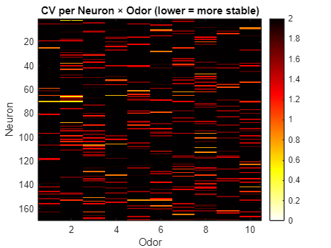
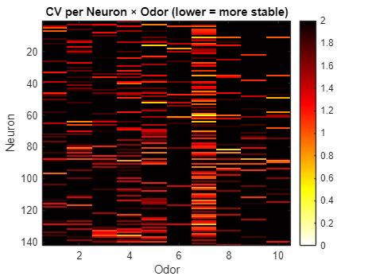
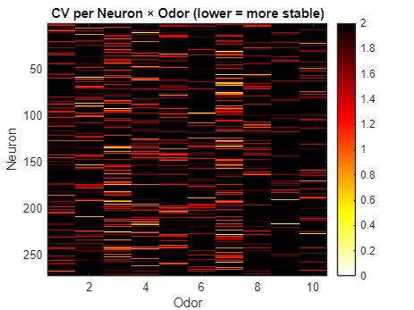
For mouse 3, interestingly, CV heatmap visualization revealed that odor 3 and odor 7 elicited more stable responses across a larger number of neurons. This is evident from the overall lower CV values in their corresponding columns, suggesting that these odors may recruit more consistent encoding patterns across the piriform cortex population
Each mouse has different odor preference.

Slide 7
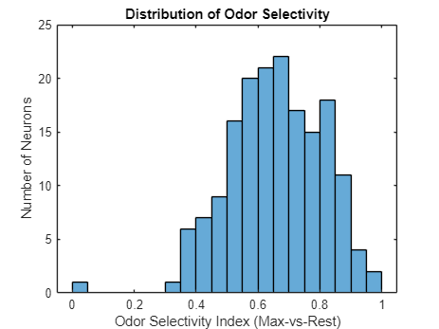
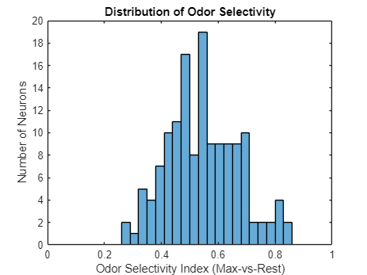
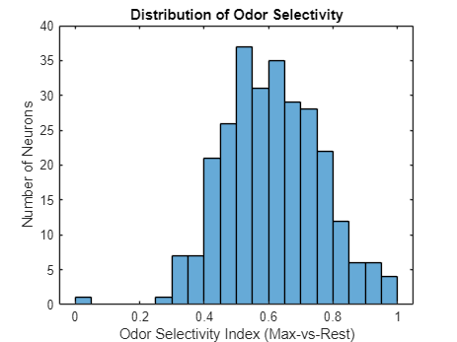
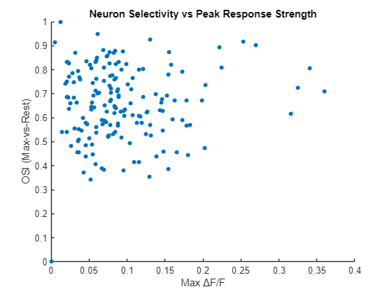
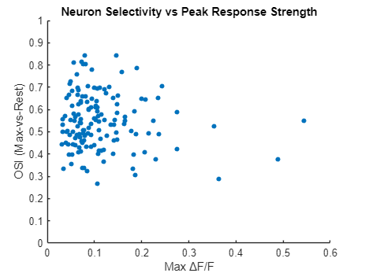
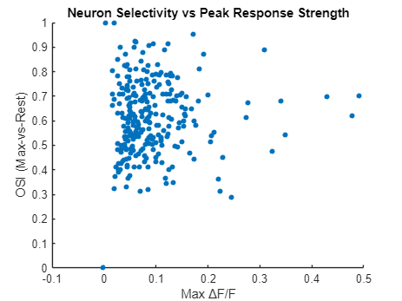
Although most neurons have relatively low mean ΔF/F across odors, the OSI distribution indicates that many neurons are still highly selective, likely responding strongly to only a subset of odors.”
The majority of piriform neurons show moderate odor-evoked responses (max ΔF/F < 0.15), yet many maintain high odor selectivity (OSI > 0.7). This suggests that odor identity coding can be implemented with relatively low response amplitude, consistent with sparse and specific encoding strategies.
Notes:
Across all three animals, only a limited number of neuron-odor pairs passed the strong-and-stable response threshold (mean ΔF/F > 0.1 and CV < 0.7). Each animal exhibited 3–4 such combinations, representing a small fraction of the total neuronal population. While these results confirm the existence of odor-evoked, reliable responses, they also highlight the sparse and variable nature of such coding across the piriform cortex.
Comparison between a moderately selective neuron (OSI = 0.61) and a highly selective neuron (OSI = 0.92) revealed distinct tuning profiles. The OSI = 0.92 neuron showed a sparse, sharply tuned response to a single odorant, consistent with a role in specific odor identity coding. In contrast, the OSI = 0.61 neuron responded to multiple odorants with varying intensity, suggesting broader tuning and possible involvement in odor generalization or category representation.
Maybe
High OSI neuron supports "sparse coding" strategy, suitable for odor classifiers and characterizing fine differencesLow OSI neurons support a "distributed coding" strategy and may be involved in context or background odor evaluation (e.g., odor intensity, familiarity)
In Aim 1, we found that most piriform neurons responded to odors with low ΔF/F amplitudes, and only a few neurons showed strong and stable responses. Despite this, a surprisingly large proportion of neurons exhibited high odor selectivity, with OSI values exceeding 0.5 in many cases. This indicates that odor identity may be encoded not by strong activation, but by sparse and highly specific response patterns.
These findings set the stage for Aim 2, where we systematically quantify odor selectivity across the population and examine its implications for odor representation.

Slide 8
Across all three animals, only a limited number of neuron-odor pairs passed the strong-and-stable response threshold (mean ΔF/F > 0.1 and CV < 0.7). Each animal exhibited 3–4 such combinations, representing a small fraction of the total neuronal population. While these results confirm the existence of odor-evoked, reliable responses, they also highlight the sparse and variable nature of such coding across the piriform cortex.
Comparison between a moderately selective neuron (OSI = 0.61) and a highly selective neuron (OSI = 0.92) revealed distinct tuning profiles. The OSI = 0.92 neuron showed a sparse, sharply tuned response to a single odorant, consistent with a role in specific odor identity coding. In contrast, the OSI = 0.61 neuron responded to multiple odorants with varying intensity, suggesting broader tuning and possible involvement in odor generalization or category representation.
Maybe, High OSI neuron supports "sparse coding" strategy, suitable for odor classifiers and characterizing fine differencesLow OSI neurons support a "distributed coding" strategy and may be involved in context or background odor evaluation (e.g., odor intensity, familiarity)
In Aim 1, we found that most piriform neurons responded to odors with low ΔF/F amplitudes, and only a few neurons showed strong and stable responses. Despite this, a surprisingly large proportion of neurons exhibited high odor selectivity, with OSI values exceeding 0.5 in many cases. This indicates that odor identity may be encoded not by strong activation, but by sparse and highly specific response patterns.
These findings set the stage for Aim 2, where we systematically quantify odor selectivity across the population and examine its implications for odor representation.

